Slide 1

RUNGTA COLLEGE OF DENTAL SCIENCES & RESEARCH
TITLE OF THE TOPIC-
ANCHORAGE IN ORTHODONTICS
DEPARTMENT OF ORTHODONTICS AND DENTOFACIAL ORTHOPAEDICS

Slide 2
Specific learning Objectives
CORE AREAS | DOMAIN | CATEGORY
CLASSIFICATION OF ANCHORAGE | COGNITIVE | MUST KNOW
INTRAORAL SOURCES OF ANCHORAGE | COGNITIVE | NICE TO KNOW
EXTRAORAL SOURCES OF ANCHORAGE | COGNITIVE | NICE TO KNOW
TYPES OF ANCHORAGE | COGNITIVE | MUST KNOW
USE OF IMPLANTS OR TEMPORARY ANCHORAGE DEVICE(TAD) | PSYCHOMOTOR | DESIRE TO KNOW
ANCHORAGE PLANNING | COGNITIVE | DESIRE TO KNOW
LOSS OF ANCHORAGE | COGNITIVE | DESIRE TO KNOW

Slide 3
CONTENTS
PART I
INTRODUCTION
CLASSIFICATION OF ANCHORAGE
INTRAORAL SOURCES OF ANCHORAGE
EXTRAORAL SOURCES OF ANCHORAGE
TYPES OF ANCHORAGE
PART II
TYPES OF ANCHORAGE
USE OF IMPLANTS OR TEMPORARY ANCHORAGE DEVICE(TAD)
ANCHORAGE PLANNING
LOSS OF ANCHORAGE

Slide 4
DEFINITION
  Graber has defined anchorage in orthodontics as the nature and degree of resistance to displacement offered by an anatomic unit for the purpose of effecting tooth movement.
  According to White and Gardiner, anchorage is the site of delivery from which a force is exerted.

Slide 5
CLASSIFICATION OF ANCHORAGE
ACCORDING TO MANNER OF FORCE APPLICATION(BY MOYER’S)
Simple anchorage
Stationary anchorage
Reciprocal anchorage
ACCORDING TO JAWS INVOLVED
Intra maxillary
Inter maxillary

Slide 6
ACCORDING TO THE SITE OF ANCHORAGE
1. INTRAORAL
2. EXTRAORAL
Cervical
Occipital
Cranial
Facial
3. MUSCULAR

Slide 7
ACCORDING TO THE NUMBER OF ANCHORAGE UNITS:
Single or primary anchorage
Compound anchorage
Multiple or reinforced anchorage

Slide 8
INTRAORAL SOURCES OF ANCHORAGE
The teeth
Alveolar bone
Basal bone
Musculature

Slide 9
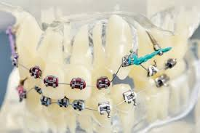
THE TEETH
Whenever some teeth are moved orthodontically , the remaining teeth of the oral cavity can act as anchorage or resistance units.
The anchorage potential of teeth depends on a number of factors such as root form, root size, number of roots, root length and root inclination.

Slide 10
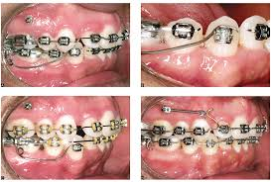
ALVEOLAR BONE
The alveolar bone that surrounds the tooth offers resistance to tooth movement up to a certain amount of force.
When the force applied exceeds a certain limit, the alveolar bone permits tooth movement by bone remodelling.

Slide 11
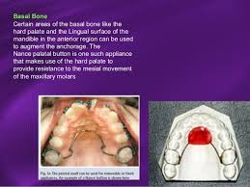
BASAL BONE
Certain areas of the basal jawbones are available intra-orally as sources of anchorage.
These areas include the hard palate and the lingual surface of the mandible in the region of the roots.
These intraoral hard areas of basal bone can be used to augment intra-maxillary or inter-maxillary anchorage.

Slide 12
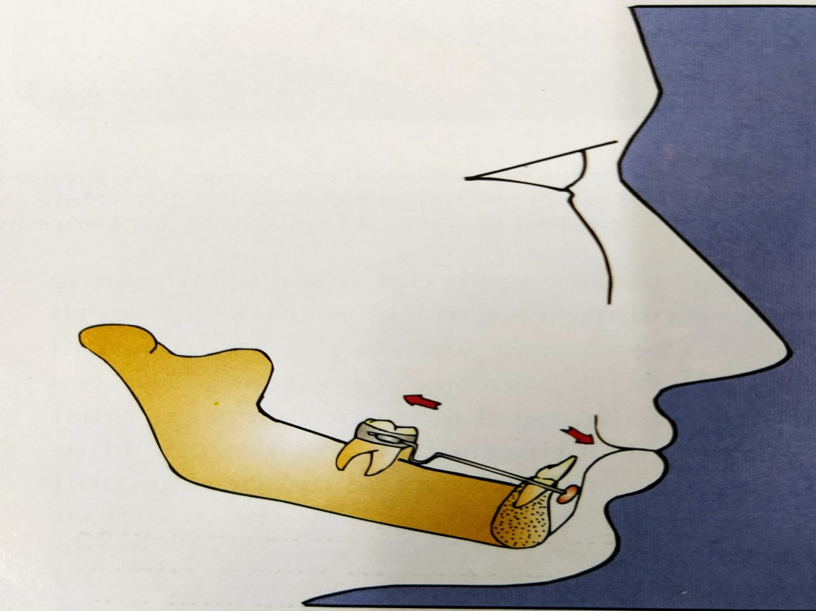
MUSCULATURE
The normal tonus of the facial and masticatory muscles plays an important role in the normal development of dental arches.
Dental anchorage may be increased by making use of hypertonic labial musculature as in the case of a lip bumper.

Slide 13
EXTRAORAL SOURCES OF ANCHORAGE
CRANIUM (OCCIPITAL OR PARIETAL ANCHORAGE) :-
Extraoral anchorage can be obtained by using headgears that derive anchorage from the occipital or parietal region of the cranium.
BACK OF THE NECK (CERVICAL ANCHORAGE) :-
Extraoral anchorage can alternatively be obtained from the neck or cervical region. Such a type of headgear is called cervical headgear.

Slide 14
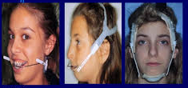
FACIAL BONES :-
The frontal bone and the mandibular symphysis offer anchorage during face mask therapy in order to protract the maxilla.

Slide 15
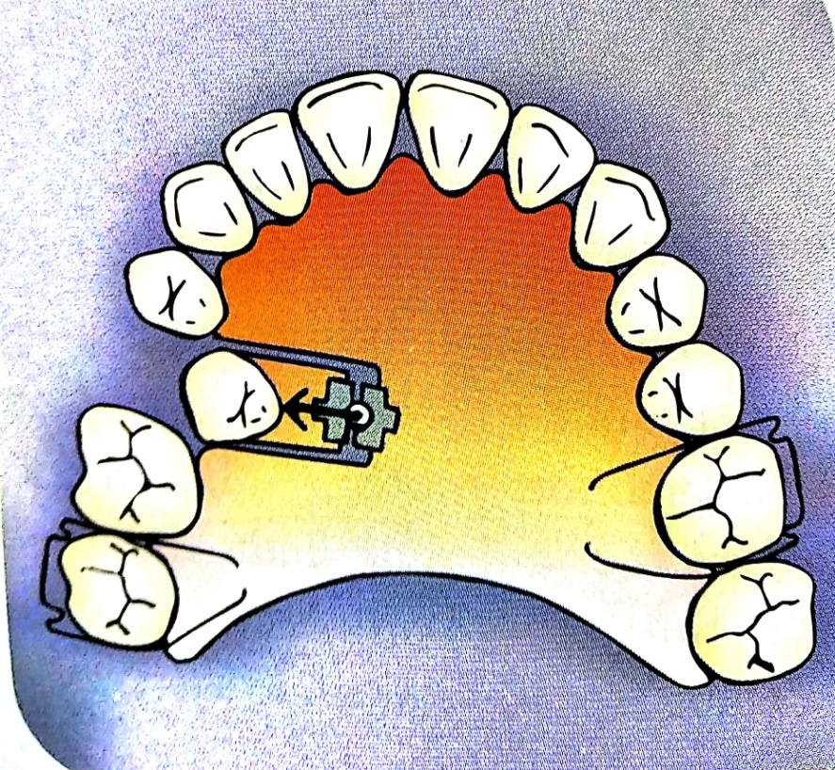
TYPES OF ANCHORAGE
SIMPLE ANCHORAGE :-
It is defined as dental anchorage in which the manner and application of force is such that it tends to change the axial inclination of the tooth or teeth that form the anchorage unit in the plane of space in which the force is being applied. Thus the resistance of the anchorage unit to tipping is utilized to move another tooth or teeth.

Slide 16
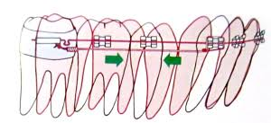
STATIONARY ANCHORAGE
It is defined as dental anchorage in which the manner and application of force tends to displace the anchorage unit bodily in the plane of space in which the force is being applied.

Slide 17
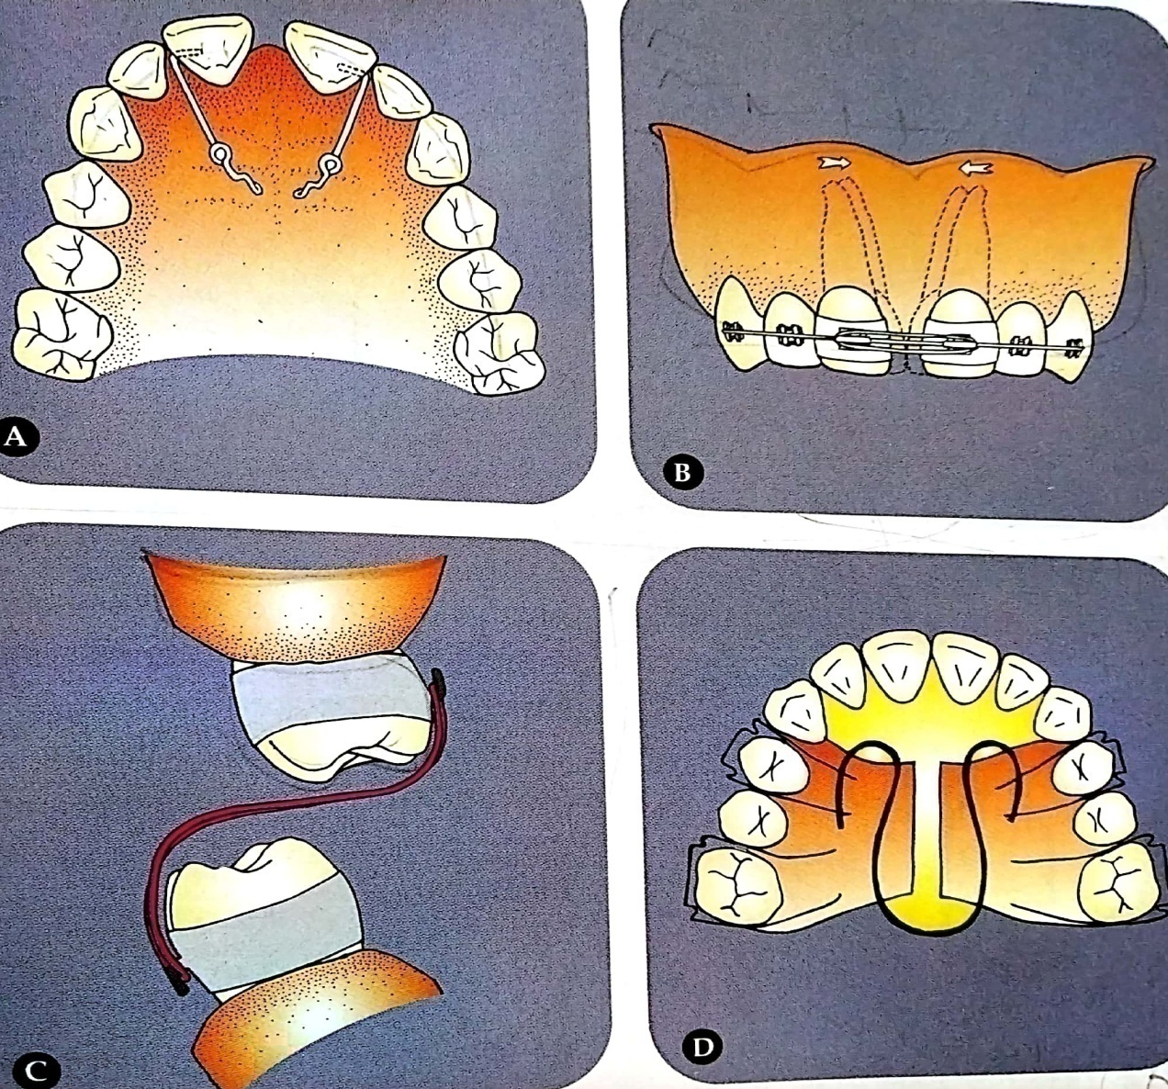
RECIPROCAL ANCHORAGE
The term refers to the resistance offered by two malposed units when the dissipation of equal and opposite forces tends to move each unit towards a more normal occlusion.

Slide 18
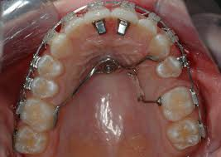
INTRAORAL ANCHORAGE
Anchorage in which all the resistance units are situated within the oral cavity.
The teeth to be moved and the anatomic areas that offer anchorage are all within the oral cavity.

Slide 19
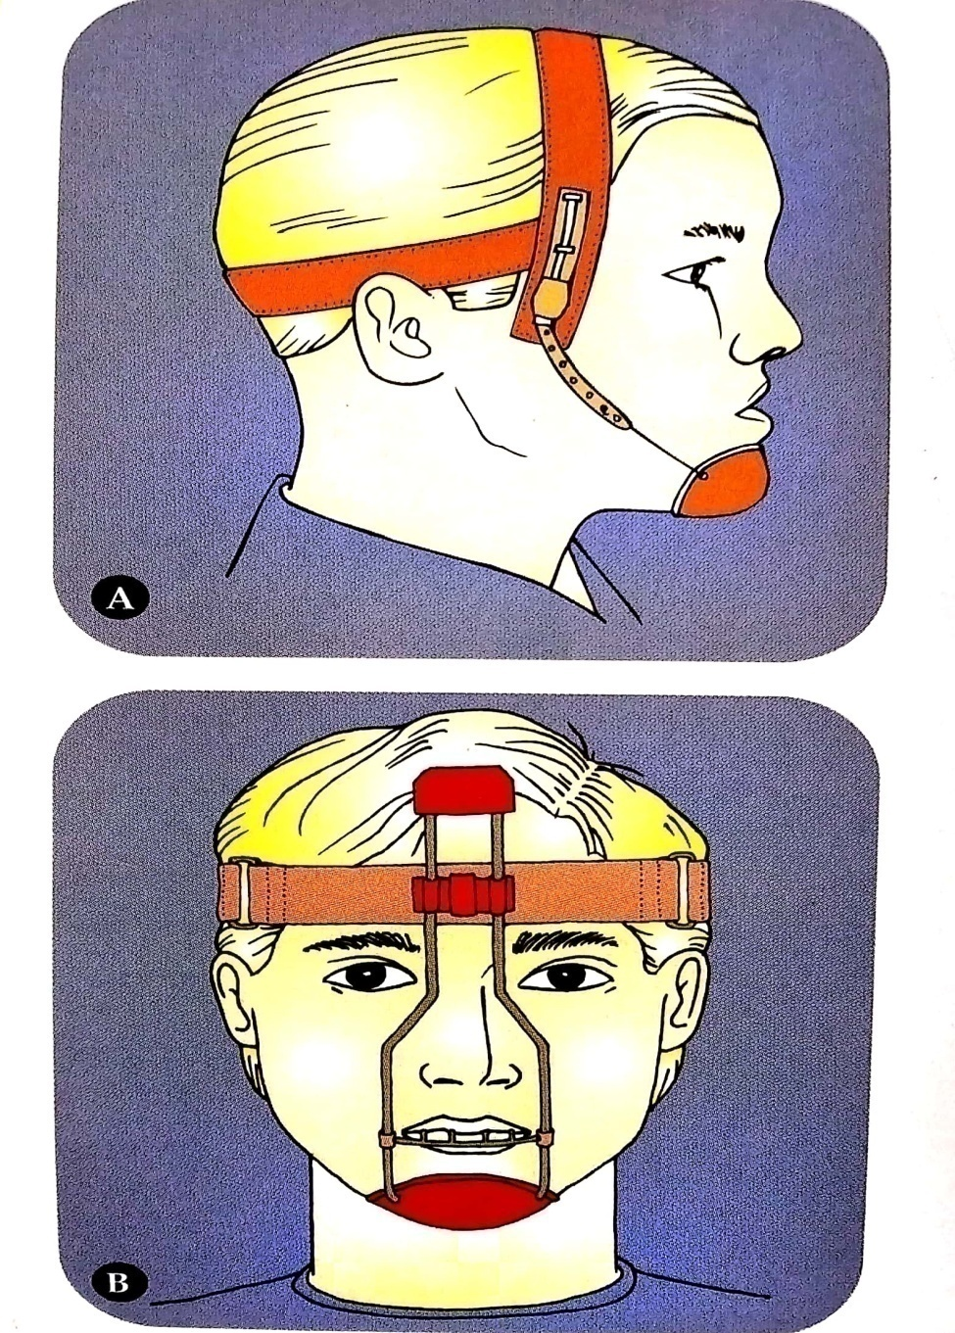
EXTRAORAL ANCHORAGE
Anchorage in which the resistance units are situated outside the oral cavity.
Various extraoral anatomic units used as sites of resistance are occiput , back of the neck, cranium and face.

Slide 20
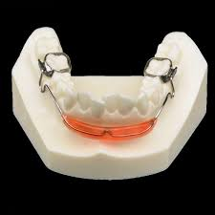
MUSCULAR ANCHORAGE
The perioral musculature is employed as resistance units.
Muscular anchorage makes use of forces generated by muscles to aid in the movement of teeth.

Slide 21
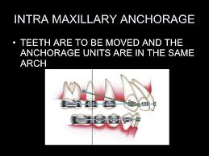
INTRA MAXILLARY ANCHORAGE
When all the units offering resistance are situated within the same jaw.
The teeth to be moved and anchorage units are all situated either entirely in the maxillary or the mandibular arches.

Slide 22
summary
For understanding anchorage, it is convenient to divide anchorage into—intraoral and extraoral anchorage. Further, intraoral anchorage can be subdivided into intramaxillary and intermaxillary anchorage. Both can be of three types—simple, stationary or reciprocal.
Simple anchorage can be further subdivided as— single, compound and reinforced.
Extraoral anchorage can be of the following types depending upon the location of the support units as— cervical, occipital, cranial or facial.

Slide 23
REFERENCES
Textbook of Orthodontics – Gurkeerat Singh, Jaypee Brothers; 2nd Edition
Orthodontics – The Art and Science, S.I Bhalajhi, AryaMedi Publishing; 7th Edition
Textbook of Orthodontics – Sridhar Premkumar, Elsevier; 1st Edition
Orthodontics: Diagnosis and Management of Malocclusion and Dentofacial Deformities – O.P Kharbanda, Elsevier; 1st Edition

Slide 24
Question & Answer Session

